Slide 1

Negative Space
Animation Critique

Slide 2
Details
Negative Space is a French 2017 Academy Awards nominated animated short
directed and written by Ru Kuwahata and Max Porter
This stop motion short is based on the poem “Negative Space” by Ron Koertge.

Slide 3
Plot
This short depicts a father-and-son relationship through the art of packing a suitcase
The son is preparing his luggage to go somewhere. In the end, it turns out that he was getting ready for his father’s funeral
Throughout the story, we get to know the son's bond with his father which they made while packing luggage for the father in the limited amount of time they were together
Notes:
Message: We have stories and poems and songs related to mothers love but rarely do we see something along the lines of fathers love. This was a breath of fresh air as it captured the subtle nature of fatherly affection. And doing it visually is a job well done.

Slide 4
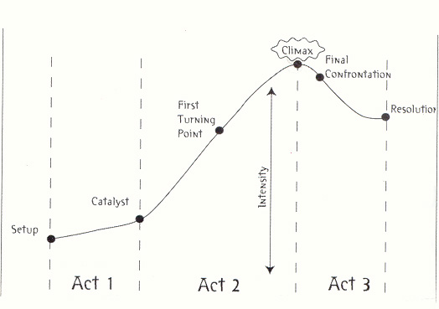
Story Structure
1st Act: We get introduced to the main character and his know how of luggage packing
2nd Act: The character backstory and relationship with his dad
3rd Act: Funeral of his father
Notes:
1. We get to know that that the main character knows how to properly pack luggage as he explains the simplistic yet tricky art form. He gets ready to go somewhere.
We don’t know as to why is he packing and where is he going with the luggage. And we are interested in finding out.
2. The first turning point or a significant plot point occurs when he reminices about the time his father taught him to pack luugage properly and how he used to feel immense satisfaction on getting approval from his dad. We get to know that this is how he bonded with his dad who was not present in the characters life very often. The climax happens when we see that he is attending his father's funeral. More appropriately when he says that he feels terrible about his fathers death. This is the most emotional moment of the second act.
3. We see that the character is looking at the coffin and thinking "Look at all that wasted space". This can be intepreted like he is missing his father and luggage terminology is the only way he can express his grief.

Slide 5
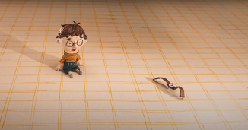
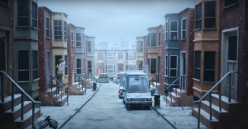
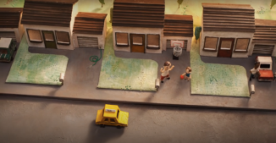
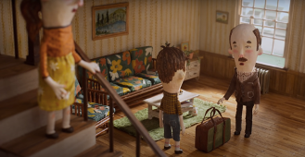
Techniques: Staging

Slide 6
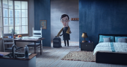

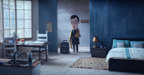

Techniques: Anticipation

Slide 7
Techniques: Appeal
In my opinion, the appeal of the characters is a bit underwhelming
All the adult characters look more or like the same.

Slide 8
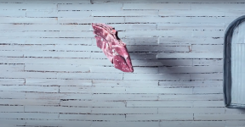

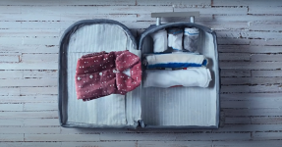
Techniques: Secondary Action

Slide 9
Techniques: Timing
Exquisite timing for everything.
The animations start and end at proper times. It is not a drag to look at and the camera cuts and scene transitions are natural.

Slide 10
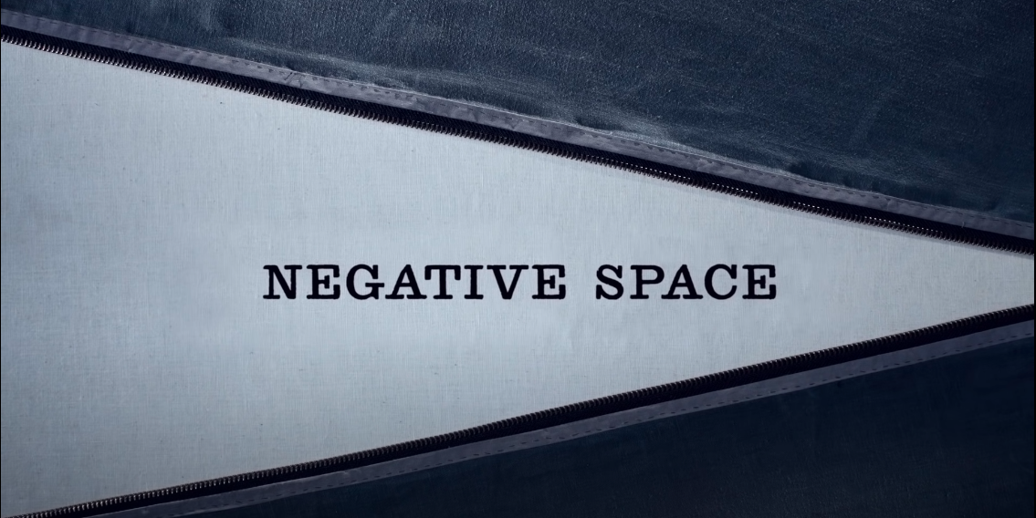
Review
Beautiful imagination of a poem into a visual form

Slide 11
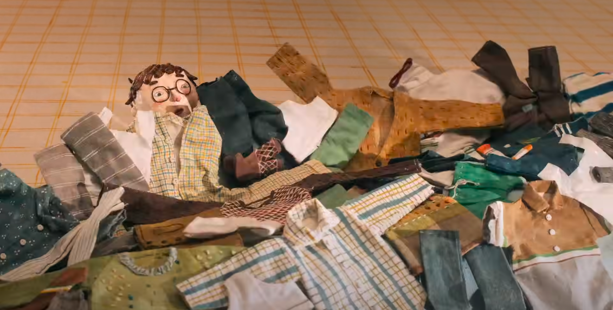
Excellent use of visual metaphors

Slide 12
Excellent use of visual metaphors

Slide 13
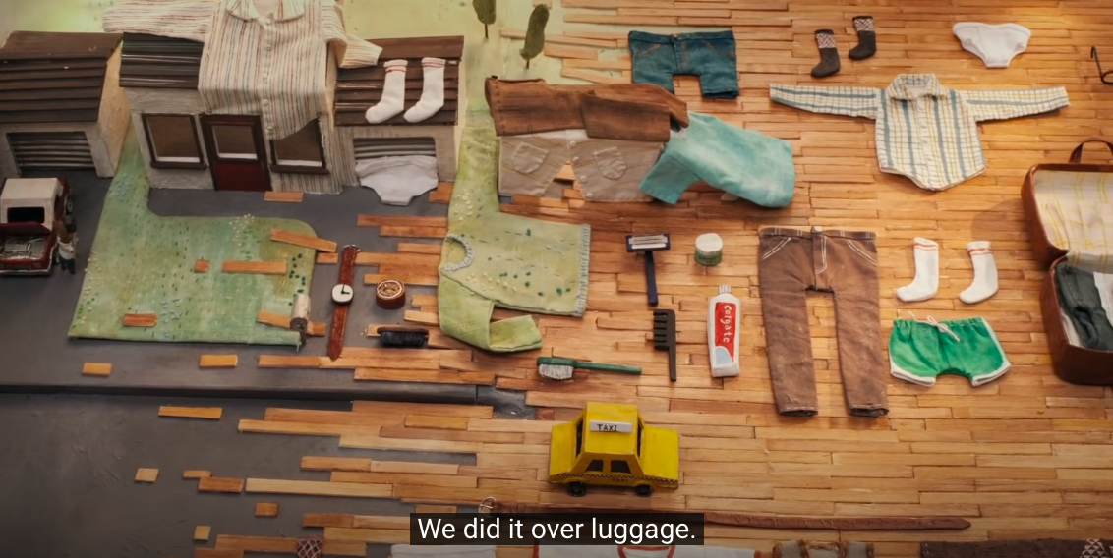
Spot on sound design of objects, characters and environments

Slide 14
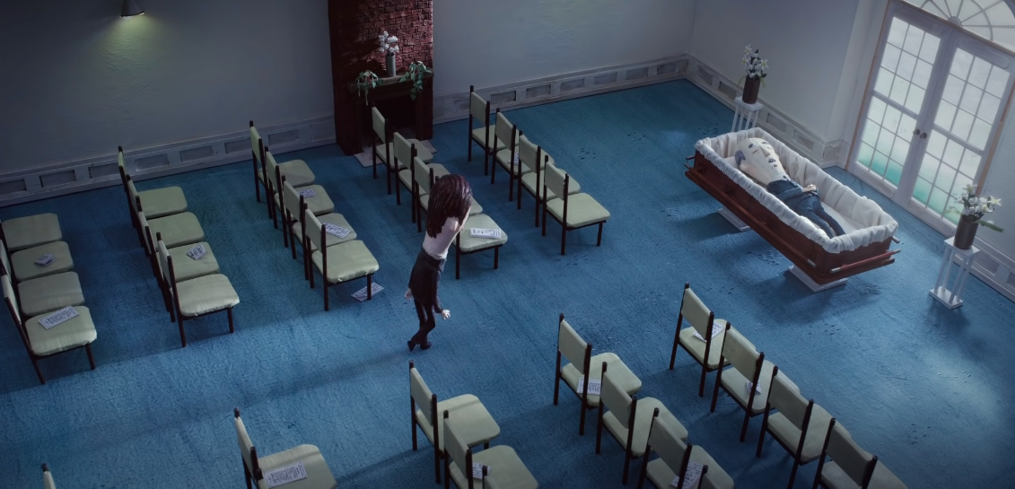
Phenomenal Staging

Slide 15
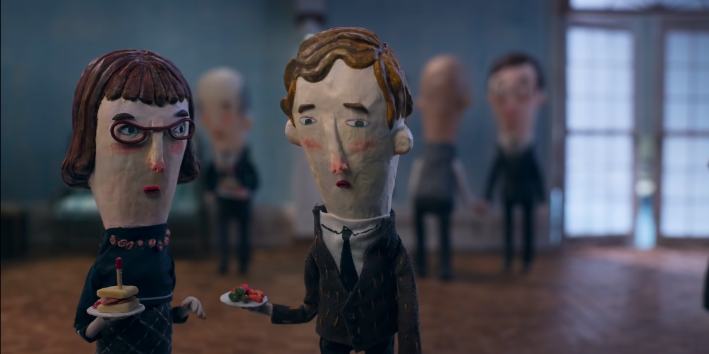
Underwhelming Appeal of the Characters

Slide 16
Final Review
"11/10 would watch again and get inspired." – me
"Touched me to the core and made me sad." - Annirudh (Cybersecurity grad student)
"I loved the sea wave scene!" - Rushali (former CGT 540 student)
"The animation was really good!" - Nidhi (a newbie to animated stuff, CIT grad student)

Slide 17

Questions/suggestions?

Slide 18

Thank You!

